Slide 1

2021

Slide 2
Data Science and AI
Presenting Skills

Slide 3
Agenda
Planning frameworks
Delivery techniques
Practical exercises

Slide 4
Impact and Effectiveness
7% What
words, ideas, data
right person, status, Intention, X-factor
40% Who
93%
gestures
voice
movement
dress
tone
visual aids
structure
53% How

Slide 5
The two elements of a good presentation
Planning
2. Delivery
Outcomes
Control
Confidence
Flexibility

Slide 6
Planning Frameworks

Slide 7
Presentation Formats
Impromptu Outline
Short Presentation Outline
Formal presentation structure

Slide 8
Essential Stages of Presenting
1
Make sure the listener is ready to receive the message
Beginning
2
Communicate the message
Middle
3
Make sure the listener has received & understood the message
End

Slide 9
Impromptu Outline
1
Tell ‘em what you’re going to tell them
Beginning
2
Tell ‘em
Middle
3
Tell ‘em what you just told them
End

Slide 10
Short Presentation Outline
1 Subject - State it
2 Agenda - Areas to be covered
Beginning
3 Body - Cover each area
Middle
End
4 Summary - Key idea from each area
5 Conclusion - Main idea, next steps, recommendation

Slide 11
Formal Presentation Structure
Opening Remarks
Beginning
Creative opening
Bridge
Subject
Agenda Item 1
Agenda Item 2
Agenda Item 3
Lead-In
Lead-In
Lead-In
Middle
Body 1
Body 2
Body 3
Mini-Conclusion
Mini-Conclusion
Mini-Conclusion
Summary 1
Summary 2
Summary 3
End
Conclusion
Notes:
Explain Whole Structure, Give Examples

Slide 12
Delivery Techniques

Slide 13
The Impact of Eye Contact
Good Use
Poor Use
Dodgy
Distrust
Trust
Genuine
Confidence
You care
Engage
Show interest
Competence
Enthusiasm
Authority
Too Much
Intimidating
Unsettling
Rude
Overbearing

Slide 14
Public Speaking Eye Contact Clusters
Stage

Slide 15
Confident Manner
Eye contact
Use pauses and silence to your advantage - Say nothing instead of “Um”
Control your pace
Use hand gestures appropriately
Move to a new position to indicate a new idea

Slide 16
Exercise: Touch, Turn, Talk
Touch - click the clicker
Turn - to the audience
Talk - make eye contact and deliver the message
Present from the following slides

Slide 17
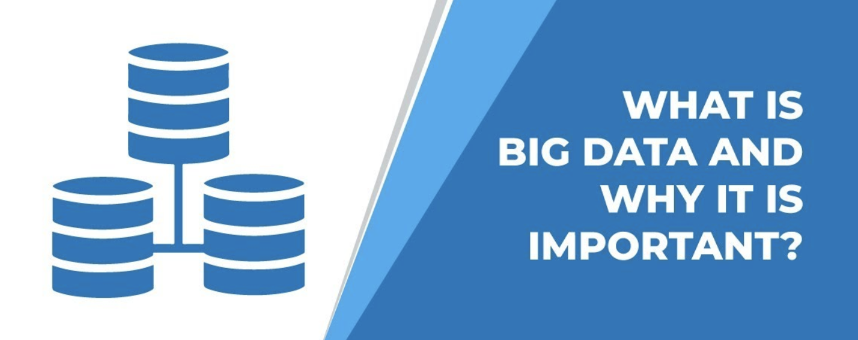

Slide 18
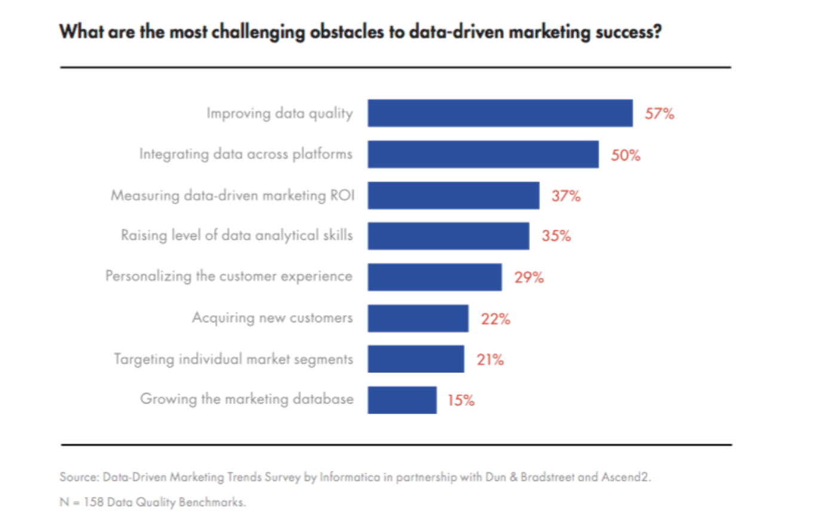
Data Driven Marketing

Slide 19
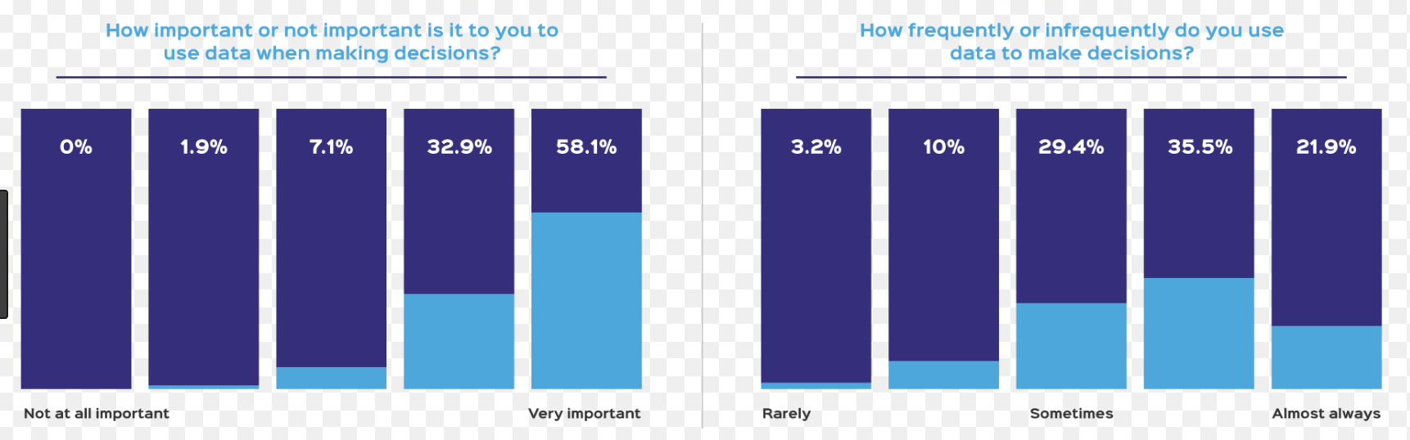
Data Driven Decisions

Slide 20
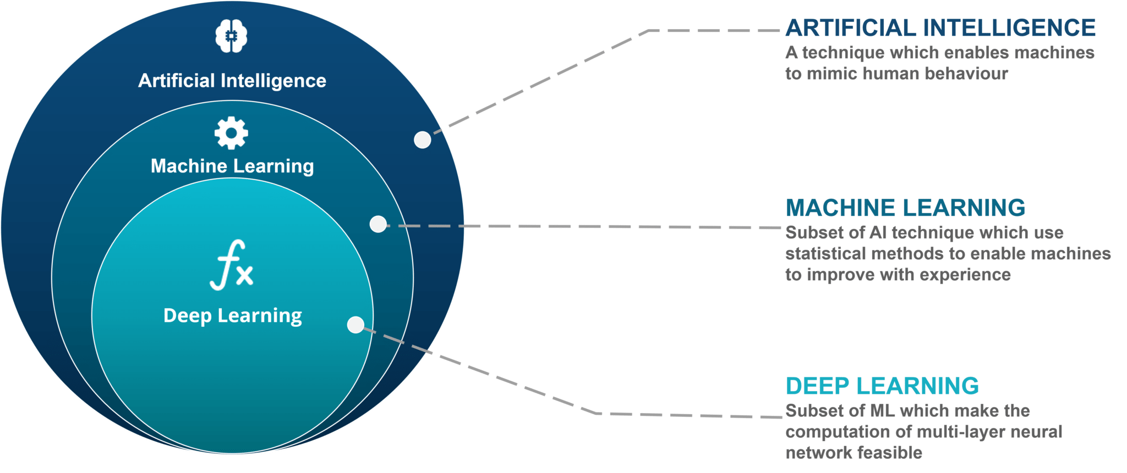
AI, ML & DL

Slide 21

ML v DL

Slide 22

3 things I like about Cats

Slide 23

Why Data is better than Ideas

Slide 24
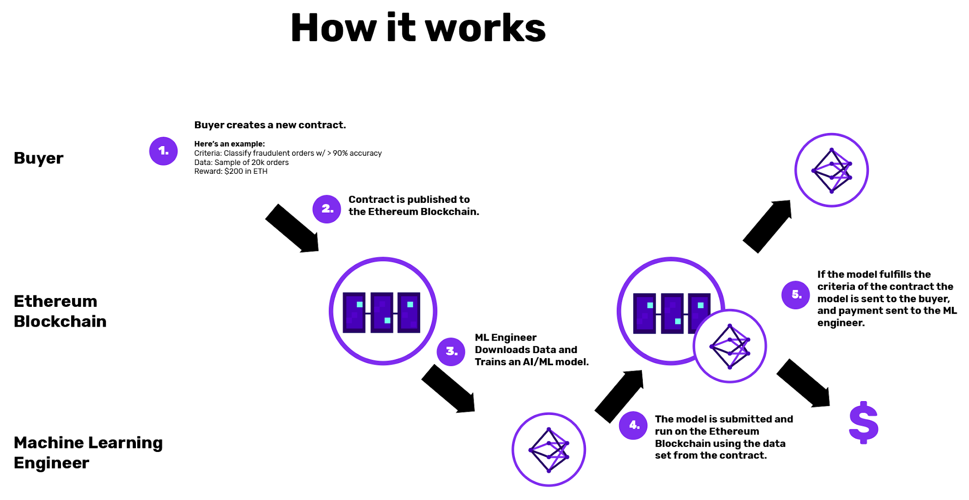
How Blockchain Works

Slide 25
Exercise: Capstone Project Presentation
Revise Capstone Presentation in light of short presentation outline or formal presentation structure
Present!

Slide 26
Wrap up
Today we covered:
Planning frameworks
Delivery techniques
Practical exercises
Do that and you’ll present with Impact and Effectiveness.

